Slide 1
Data 101
Data Literacy
Prof. Tomasz Imielinski

Slide 2
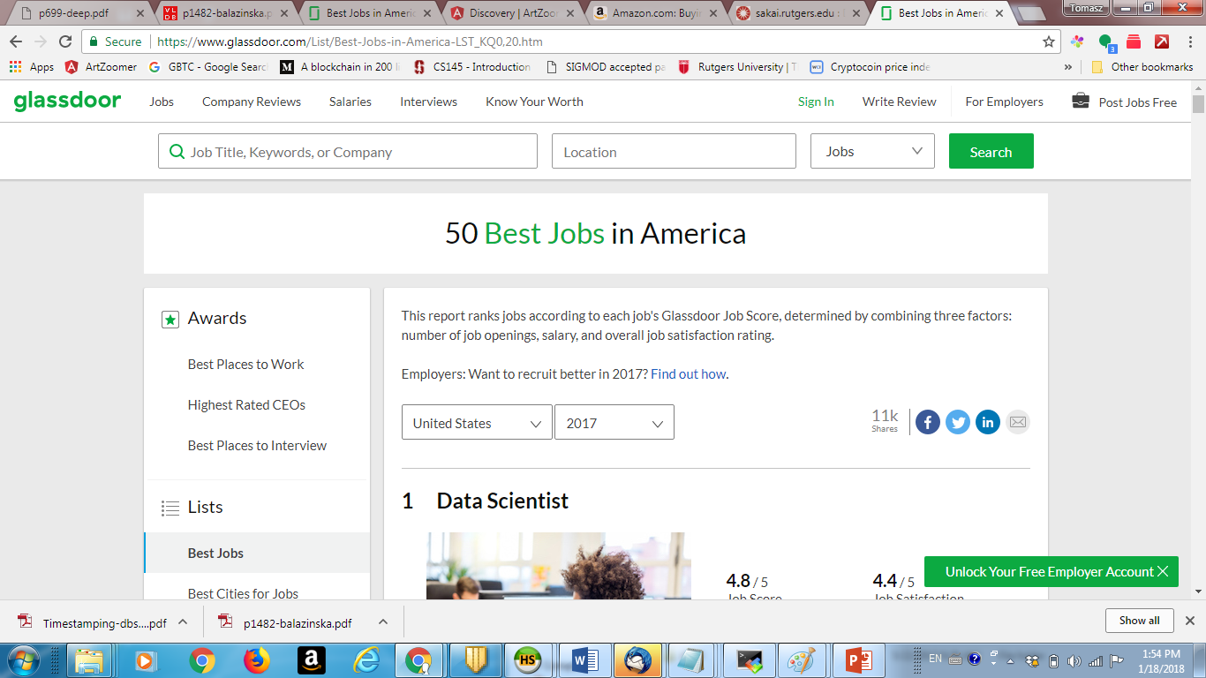
Glassdoor: best jobs in 2018

Slide 3
Data Literacy Signature Class
Objectives:
University wide, signature class
Any student taking the class should become “Data Literate”

Slide 4
“Your class just got me a job”
Messages like this make my day
Last week from one of my spring 2017 students – about job in LA

Slide 5
This class is a lot of work!
READ SAKAI ANNOUCMENTS – make sure you aware of weekly activities!
Have clicker? If not, get one – we will use it
Attend recitations (specially if you new to programming)
Every week there is something to do…..

Slide 6
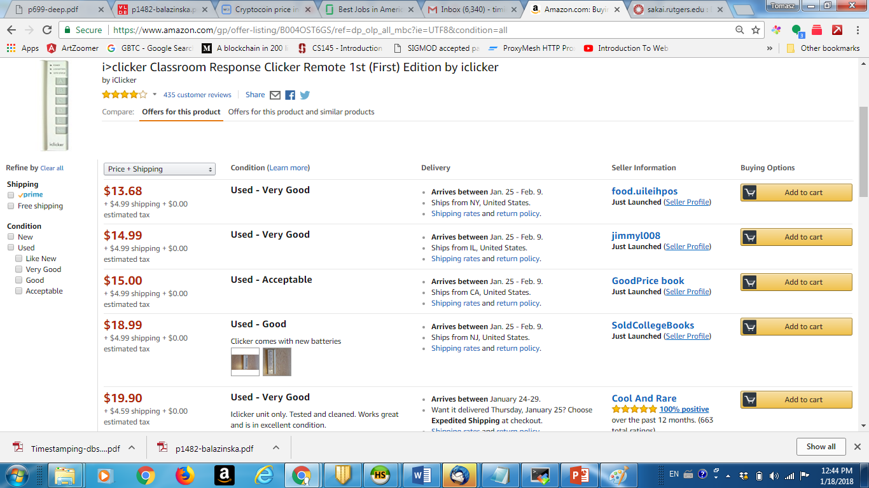
Clicker

Slide 7
FRIENDLY WARNING
If you are not ready to work hard – submit solutions to 15 weekly data puzzles, compete in Prediction challenge
If you just taking this class because it counts for Twenty First century credit etc – but otherwise do not care about the subject
ADJUST or DROP OUT

Slide 8
HELP is HERE but need to use it!
Recitations
data101@googlegroups.com
Office hours for 8 Tas + Professor
Most of the code if not all is on data101@cs.rutgers.edu web site at
http://data101.cs.rutgers.edu/laboratory/

Slide 9
Data Literate?
What does this mean and why should I care?

Slide 10
Why do we need a signature class about “data”?
New York Times: Thomas Friedman, March 5^{th,} 2013
http://www.nytimes.com/2013/03/06/opinion/friedman-the-professors-big-stage.html?src=recg&_r=0
NYT predicts massive openings in jobs on data science: “A report last year by the the research arm of the consulting firm, projected that the United States needs 140,000 to 190,000 more workers with ‘deep analytical’ expertise and 1.5 million more data-literate managers, whether retrained or hired.”

Slide 11
Data Literacy
Combination of statistics, database management, and data extraction and cleaning.
It will soon be as important as “expository writing”
Some programming is a must.
It will allow you to find data, extract it, analyze it and draw statistically valid conclusions which are important and actionable to your line of business, whatever that business is.

Slide 12
Data Literacy
Common sense probabilistic reasoning (Bayesian)
Know when data is used in the news correctly – it is part of being a citizen – since data may often be used to fool you, terrorize you or simply used against you
Healthy skepticism – know how to ask right questions.

Slide 13
MOTIVATION
“This is why data literacy ranks as a key skill, equivalent to the ability to read and write”
(Friedman, NYT 2013)

Slide 14
Data Scientist: The Sexiest Job of the 21st Century (Harvard Review 2014)
The Hot Job of the Decade
“The sexy job in the next 10 years will be statisticians… People think I’m joking, but who would’ve guessed that computer engineers would’ve been the sexy job of the 1990s?” -Hal Varian, Chief Economist of Google
“There simply aren’t a lot of people with their combination of scientific background and computational and analytical skills for data science.”
“Data scientists today are akin to Wall Street ‘quants’ of the 1980s and 1990s.“

Slide 15
Even if you don’t become a data scientist, you may very likely…
Be conducting and presenting your own data analyses.
We do HOPE that it is not like the next two slides…

Slide 16
Examples
You will look at data analytics reports on traffic to your web site or your company’s web site.
You may be responsible for interpreting this data. OR
You may be making decisions on the basis of this data.

Slide 17
Questions your boss may ask you:
Internet. Did we get more web traffic as a result of our advertising campaign? Should we continue spending $$ on it?
Politics. Are we gaining political support in a given demographic as a result of our door-to-door effort?
Crime. Is the crime rate going down as result of more gun control measures?
Retail. Should we adjust our prices as oil prices go down?

Slide 18
Tell a story with data
One of the most important skills in data science is the ability to tell a story with data, beyond just pointing to the numbers.
SEE IT: Today’s new visualization tools make it easier to display data in formats that non-scientists might be able to (or want to) consume.
TALK ABOUT IT: All the charts in the world won’t make a difference if you can’t communicate to product managers or executives why your findings matter.

Slide 19
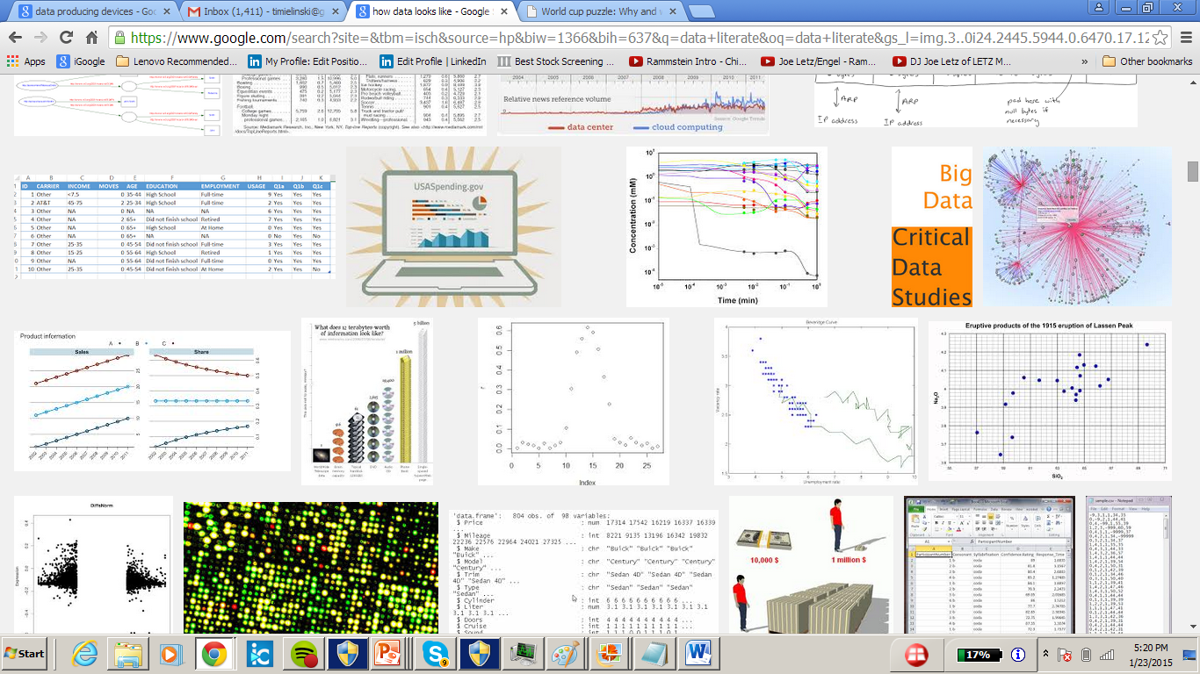
What does data look like?

Slide 20
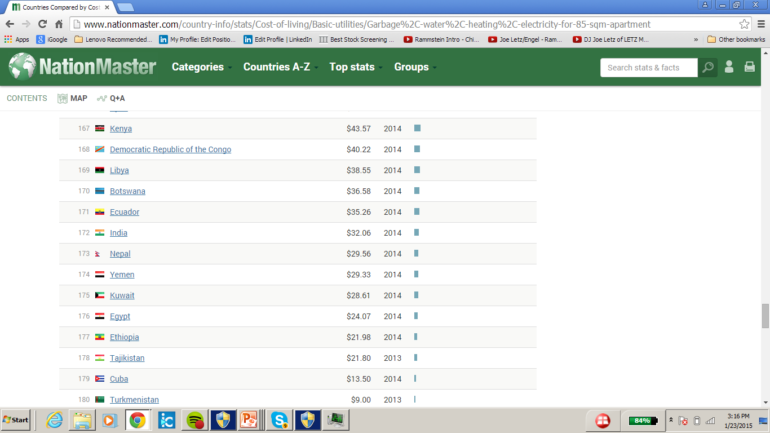
Cost of living > Basic utilities > Garbage, water, heating, electricity for 85 sqm apartment: Least expensive countries

Slide 21
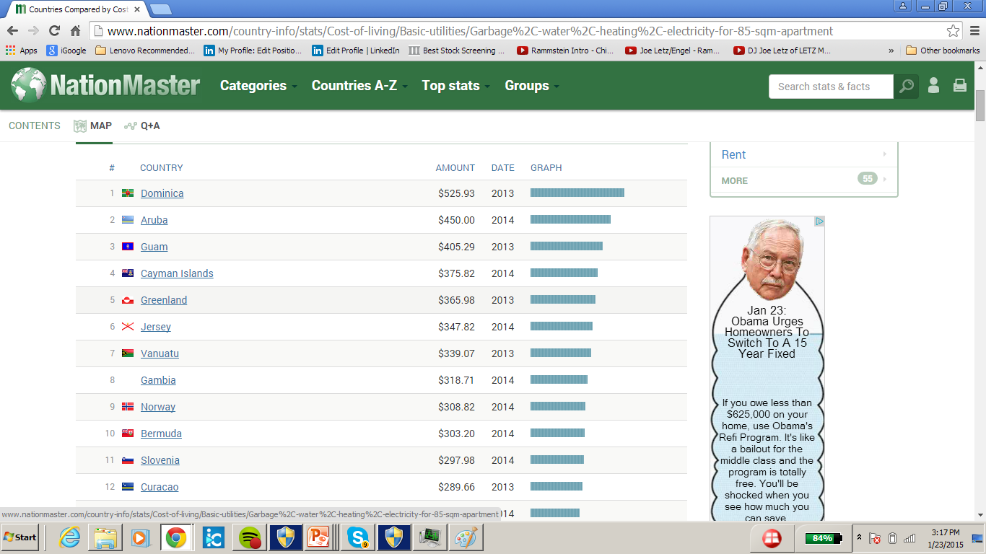
Cost of living > Basic utilities > Garbage, water, heating, electricity for 85 sqm apartment: Most expensive countries

Slide 22
Big data in numbers
How much data is there?
In 2013, we (humans) created or copied 4.4 zettabytes of data.
4.4 zettabytes = 4.4 trillion gigabytes.
If we stacked-up enough iPads to hold this much data, the stack would reach 2/3 of the way to the moon.
By 2020, we will create 44 zettabytes of data annually.

Slide 23
What is a zettabyte?
1 ZB = 10¹² (one trillion) gigabytes = 10²¹ bytes = 1,000,000,000,000,000,000,000 bytes

Slide 24
Where does data come from?
The web (text, web pages, structured data), social networks.
User actions: clicks, minutes to listen.
Devices: fitbit, jawbone, car, home appliances, phones, cameras, etc.
Science: Biology, astronomy, geology, physics, etc.
Finance.
Data is everywhere

Slide 25
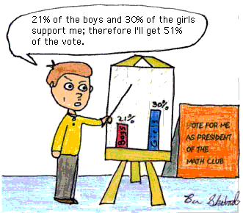
Misuses of statistics and data
Be careful!

Slide 26
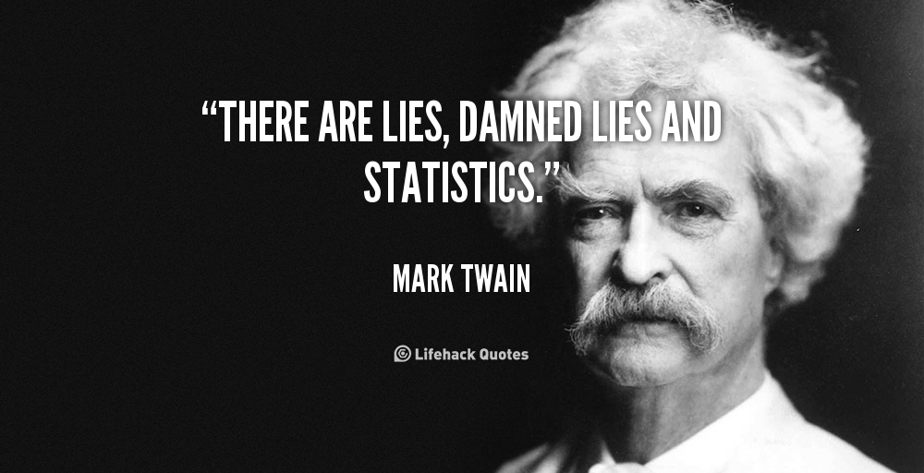
Misuses of statistics

Slide 27
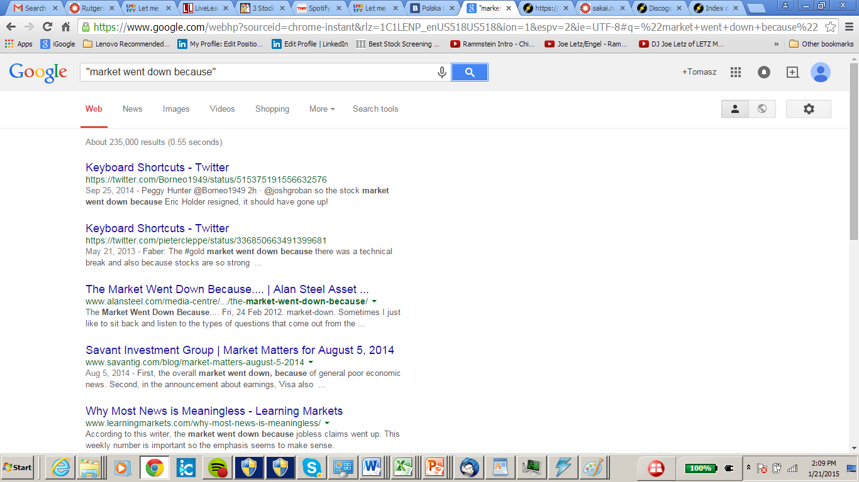
Why did the stock market go down?

Slide 28
Some of the reasons…
“The stock market went down because the economy is strong.”
“First, the overall market went down, because of general poor economic news.”
“The stock market went down because the real estate was covering the loans, so when the real estate market went down, the banks found that they did not have the securities to back these loans.”

Slide 29
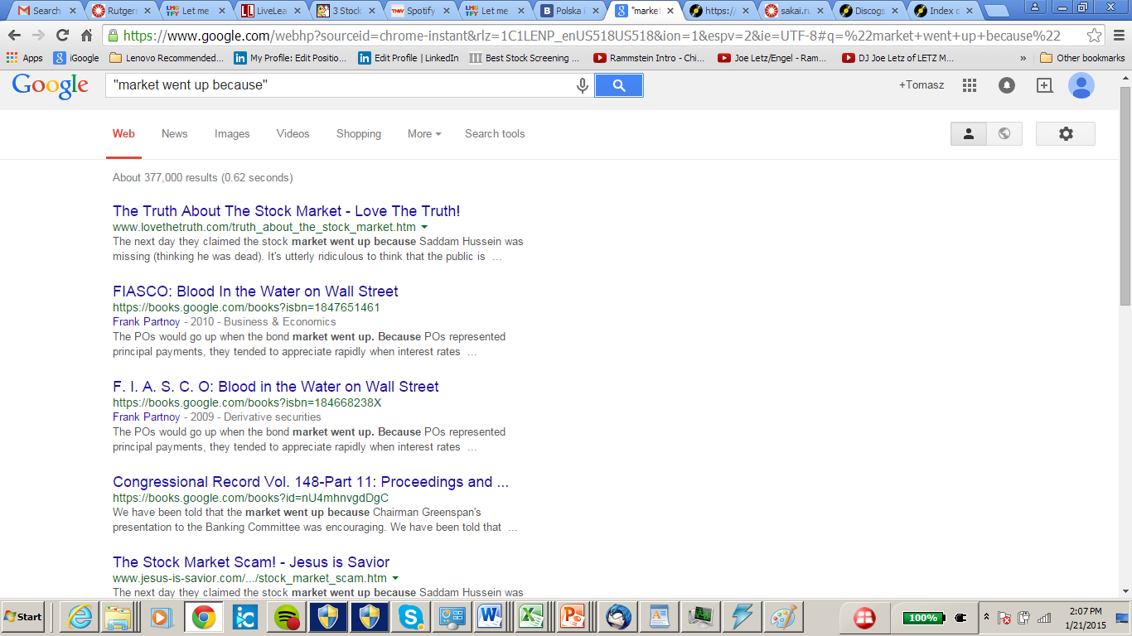
Why did the stock market go up?

Slide 30
Correlation is not causation
http://www.tylervigen.com/spurious-correlations
http://www.fastcodesign.com/3030529/infographic-of-the-day/hilarious-graphs-prove-that-correlation-isnt-causation

Slide 31
What does it mean that a test is 99% accurate?
Suppose someone claims that a medical test for some disease is “99% accurate.”
:Correctness Does this mean that if you have the disease, then there’s a 99% chance that the test will discover it?
False Positives: What about if you don’t have the disease? What’s the chance that the test will (falsely) indicate that you do have the disease?

Slide 32
“Student” is the most dangerous profession
The most dangerous profession. In a study of the ages and professions of deceased men, it was found that the profession with the lowest average age of death was “student.”
Why does being a student appear to be so dangerous?

Slide 33
Barroom brawls
A study of fights in bars in which someone was killed found that, in 90% of the cases, the person who started the fight was the one who died.

Slide 34
Be wary of false conclusions and over-skepticism
A study found that the average age of death of left-handers was about 8 years less than that of right-handers.
The authors of the study went on to speculate about reasons why left-handers may be more likely to die at a younger age.
If many people born 60 or more years ago were forced to use their right hands, then the probability of being left-handed would be higher for younger people, and this would result in a lower average age of death for left-handers, even in the absence of any greater risk of death for the individuals.

Slide 35
Big data: Are we making a big mistake?
Big data is a vague term for a massive phenomenon that has rapidly become an obsession with entrepreneurs, scientists, governments and the media.
Financial Times Magazine – March 28th 2014
But is it useful?

Slide 36
Where to find interesting data?
Usable immediately
Various formats: .xls, .csv (universal)
Search for .xls or other files
Sites: Kaggle, UCI machine learning repository, NationMaster, Dream Challenges, …

Slide 37
Some resources and examples from the popular press
NYT Times http://www.nytimes.com/interactive/2012/08/05/sports/olympics/the-100-meter-dash-one-race-every-medalist-ever.html
Nate Silver http://fivethirtyeight.com/datalab/meet-the-80-people-who-are-as-rich-as-half-the-world/
More guns less crime? http://www.infowars.com/statistics-prove-more-guns-less-crime/
http://www.nationmaster.com/
http://www.nfl.com/stats/player
http://www.google.com/advanced_search
https://www.google.com/search? as_q=ebola&as_epq=&as_oq=&as_eq=&as_nlo=&as_nhi=&lr=&cr=&as_qdr=all&as_sitesearch=&as_occt=any&safe=images&tbs=&as_filetype=xls&as_rights=&gws_rd=ssl
http://www.census.gov/censusexplorer/
http://www.census.gov/censusexplorer/censusexplorer-youngadults.html
http://www.dhs.gov/recreational-boat-and-accident-reporting
https://www.fema.gov/data-feeds
http://www.nytimes.com/newsgraphics/2013/12/30/year-in-interactive-storytelling/#dataviz

Slide 38
Visualization of historical data on the Olympics
http://www.nytimes.com/interactive/2012/08/05/sports/olympics/the-100-meter-dash-one-race-every-medalist-ever.html

Slide 39
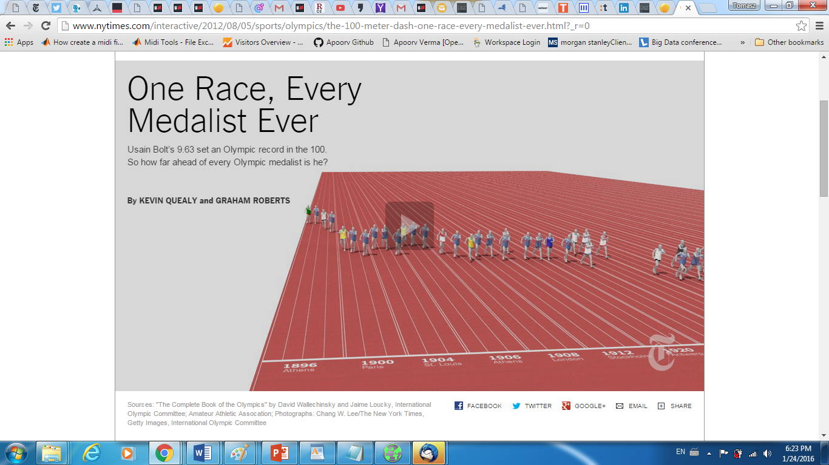

Slide 40
Two classes a week
Tuesday class: Concepts, statistics, clicker quizzes
Friday class: also Court of data
Next week’s assignment (Due next Friday): Find interesting data sets on the internet and create power point presentation – so you can present if you are SELECTED for the court of data

Slide 41
Main components of the final grade
Data Puzzles (weekly, basic R)
Data&Society challenges (2-3)
Prediction Challenge – “April Madness”
Usual: Midterm and Data Literacy Exam (final)

Slide 42
Learning basic R
data101.cs.rutgers.edu/laboratory
data101.cs.rutgers.edu
Recitations – please bring your laptop
Critical to attend – hands on instruction

Slide 43
More on R
We will start with plots
Permutation tests, basic statistical tests for hypothesis testing
Machine learning (yes!)
R is like a crude smart phone with most apps!
Any cutting edge data science method – is available….

Slide 44
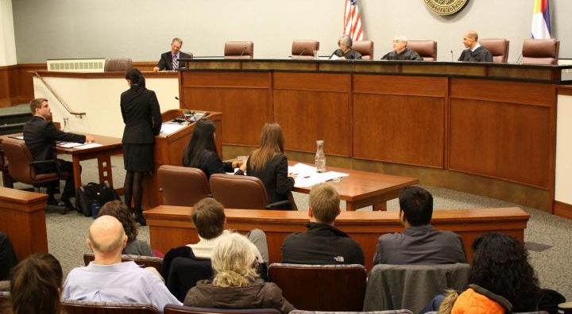
COURT OF DATA

Slide 45

And in the court of data we find your analysis……Correct!

Slide 46
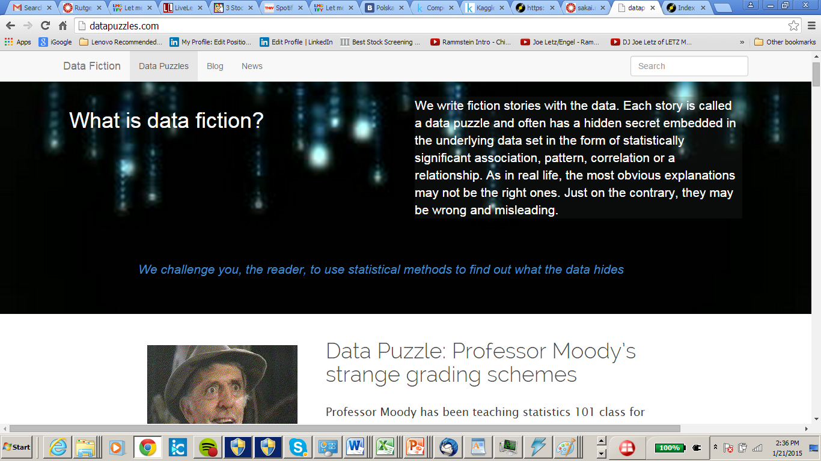
Data puzzles

Slide 47
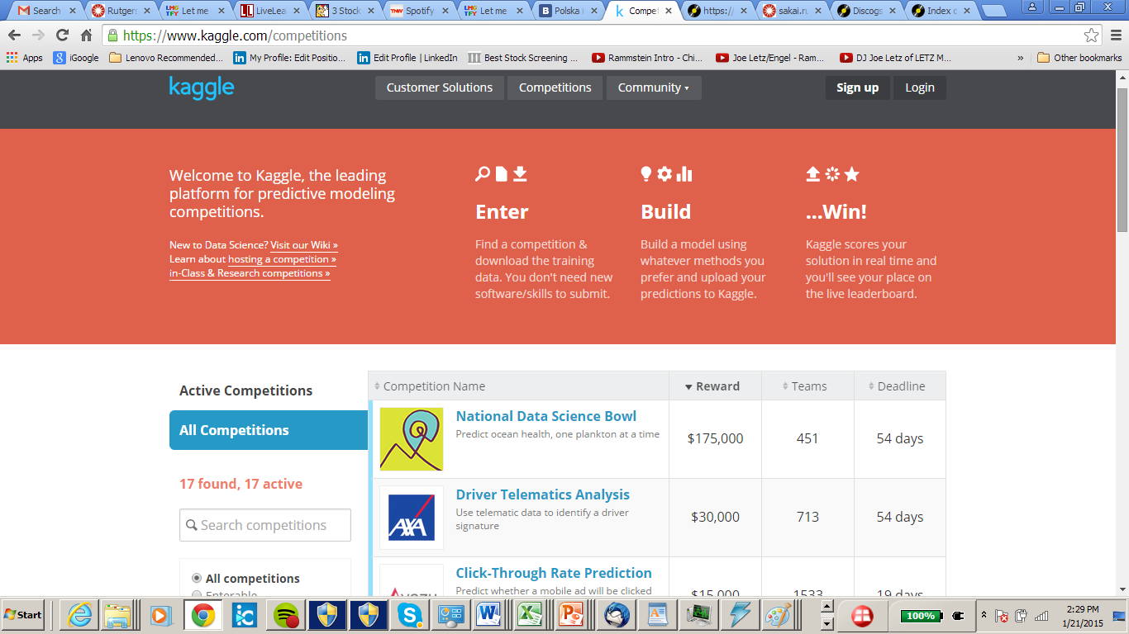
Kaggle – data competitions

Slide 48
How is this class different…
…from other statistics and data science 101 classes?

Slide 49
Answer
Data puzzles – learning by solving them.
Data Court – presenting your findings and hearing the jury’s verdict.

Slide 50
Class Basics
Instructors: Prof. Tomasz Imielinski (CS)
EMAIL timielinski@gmail.com
Office CORE 330
Office Hours: Friday 2-3:30PM
8 recitation TAs
Grading: 65%: weekly data puzzles, data&society challenges, prediction challenges
10%: midterm
25%: Data Literacy exam
Website: sakai.rutgers.edu, data101.cs.rutgers.edu, data101.cs.rutgers.edu/laboratory, foreveranalytics:5000

Slide 51
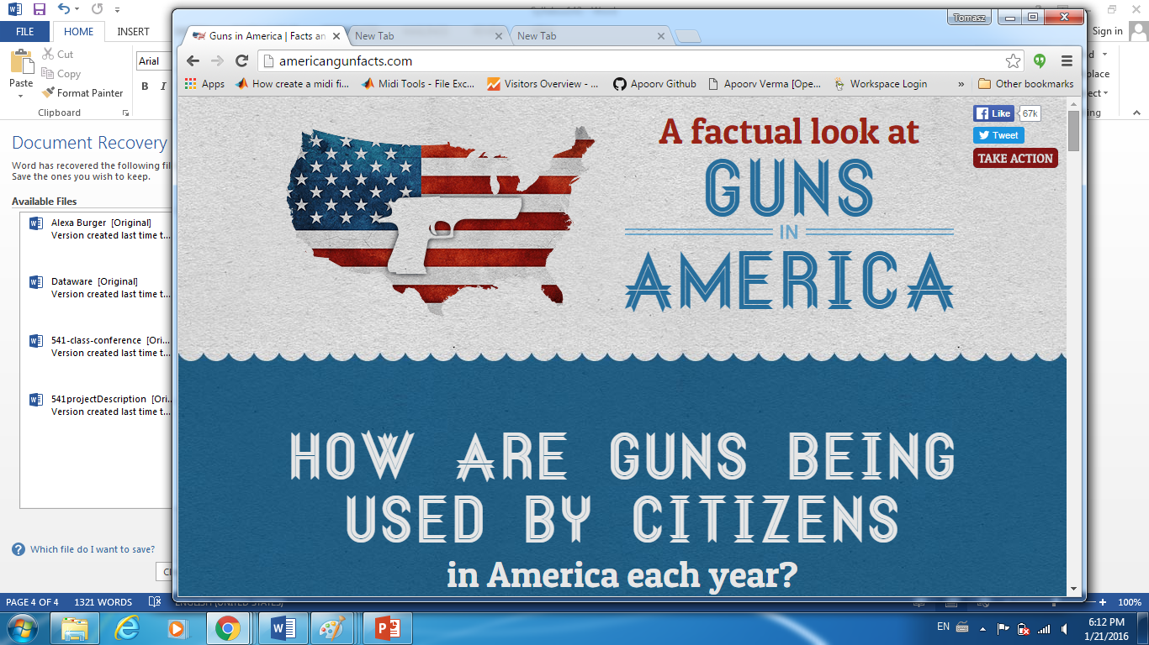
Project: Data and Society

Slide 52
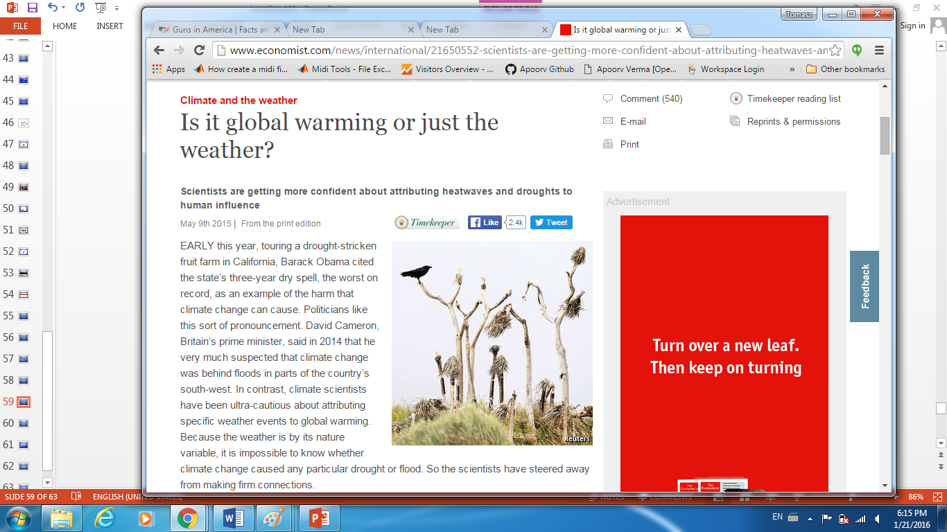
Data and Society

Slide 53
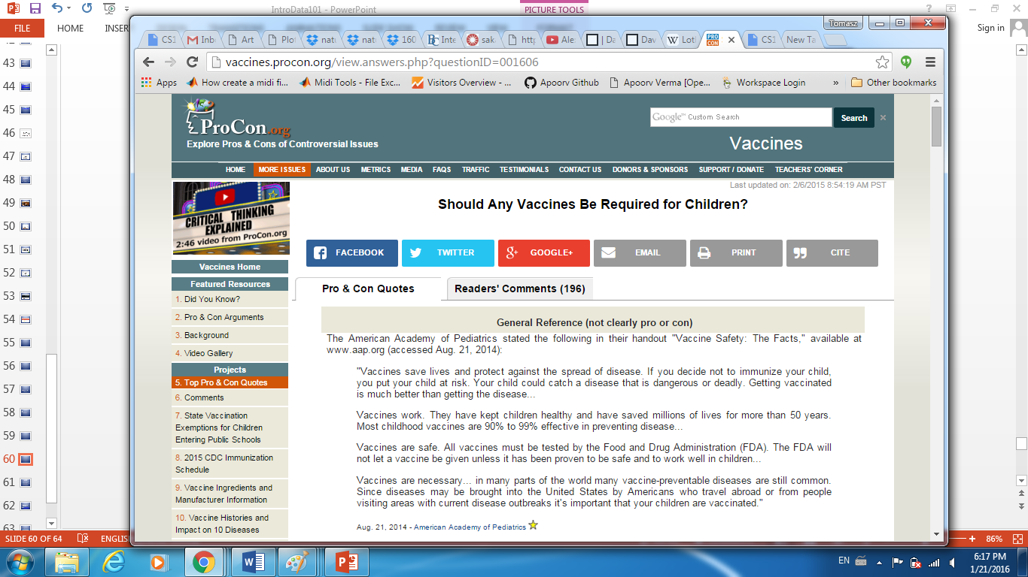
Data and Society

Slide 54
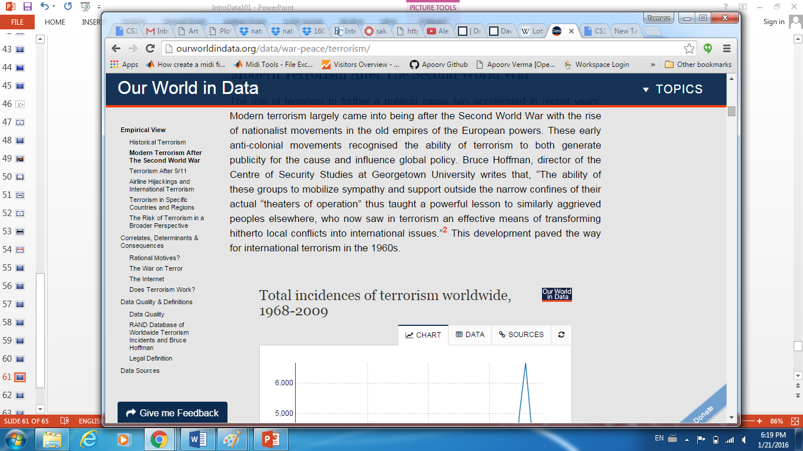
Data and Society

Slide 55
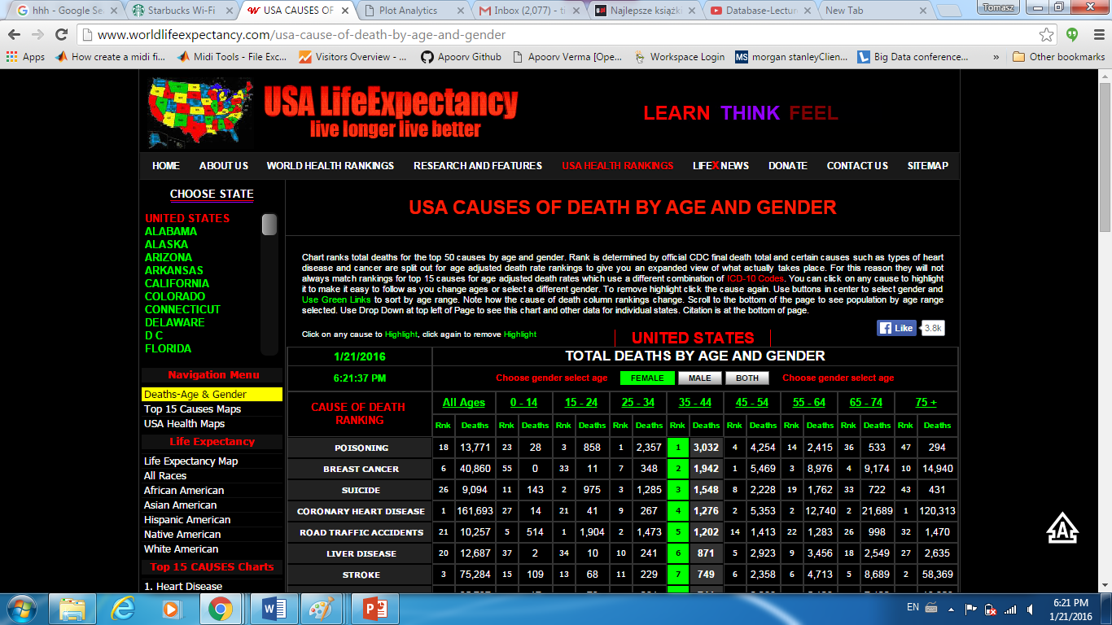
Data and Society

Slide 56
Guidelines for weekly challenges and the court of data
Weekly challenges, to be completed individually
Each submission should contain:
1 .ppt file, describing your results.
1 .R file (R code), showing how your results were obtained using R.
Court of data
After each submission, we will select a pre-specified number of students to present in the Court of Data
Students selected for the court of data won’t be announced. Every student should be prepared to present

Slide 57
Class references
Statistics references
OpenIntro statistics: https://www.openintro.org/stat/textbook.php
Introductory statistics textbook (somewhat standard, but well done)
Various online courses, available through Coursera (https://www.coursera.org/). For example, see:
Statistics: Making sense of data (from University of Toronto)
Statistics one (from Princeton University)
R references
Download R: http://www.r-project.org/, http://www.rstudio.com/
data101.cs.rutgers.edu/laboratory
Learn R online: http://tryr.codeschool.com/
R at OpenIntro: https://www.openintro.org/stat/labs.php
Other R resources: http://cran.r-project.org/doc/manuals/R-intro.pdf, http://cran.r-project.org/doc/contrib/Torfs+Brauer-Short-R-Intro.pdf

Slide 58
First Challenge
Find an interesting data set.
Describe the data and convince us that it’s interesting.
Load the data into R and make some plots.
Submit this assignment on Sakai by next WED 11pm
Format: Powerpoint + R code

Slide 59
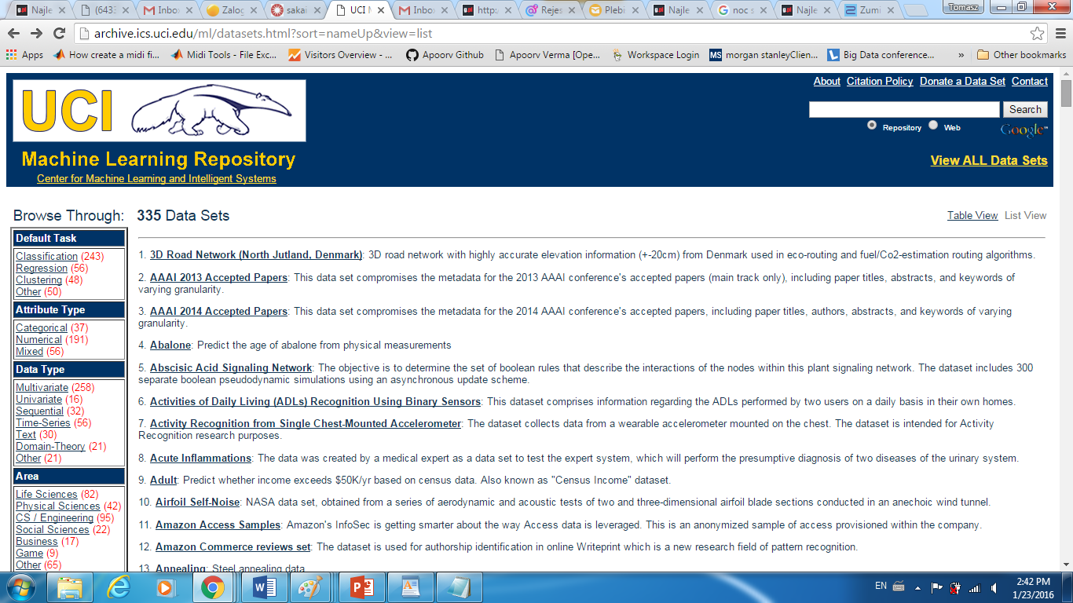
Data Sources

Slide 60
Other sources
Kaggle.com
Data.gov
Sports data – nba, nfl, mlb….

Slide 61
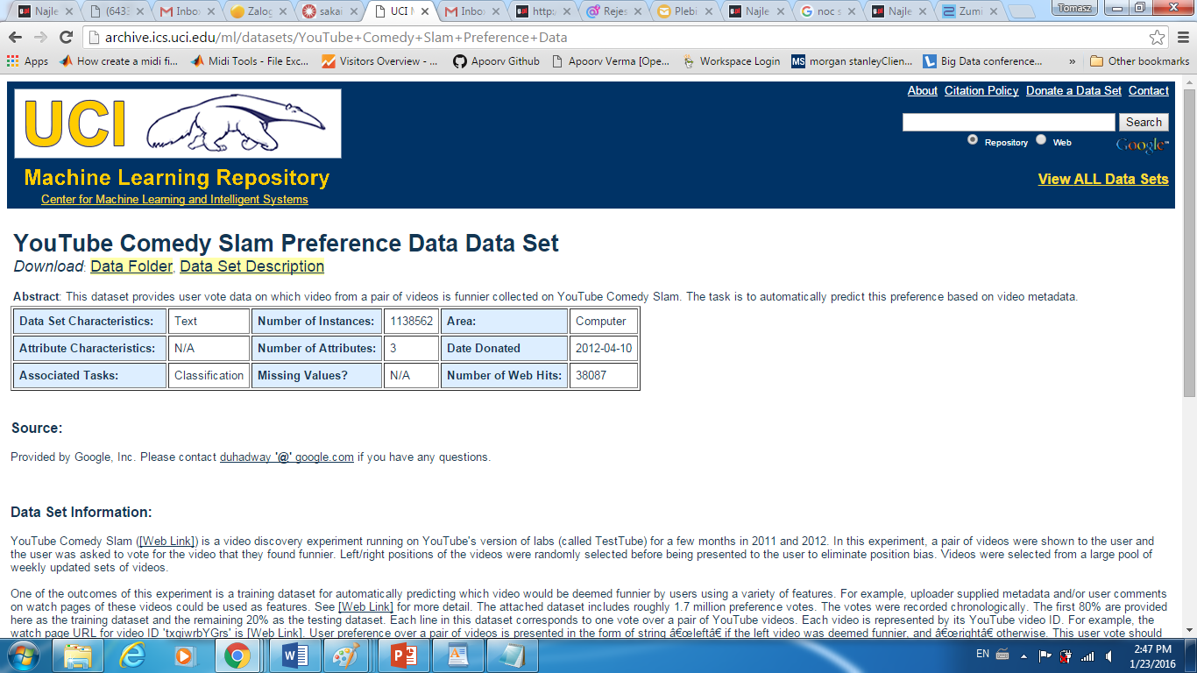
Data Source Example

Slide 62
Google it!
“Crime data”
“Global warming data”
“NBA data”

